Slide 1




AI-POWERED RESUME SCREENING AND RANKING SYSTEM
Team : Name - Mridul Singh Rajput & Email id - mridul.raj.2222@gmail.com Guide : Soamya A. Chaudhary
Disclaimer: The content is curated for educational purposes only.
Notes:
Slides: Prepare a short slide deck (10-12 slides) summarizing the project objectives, methodology, and key results.

Slide 2
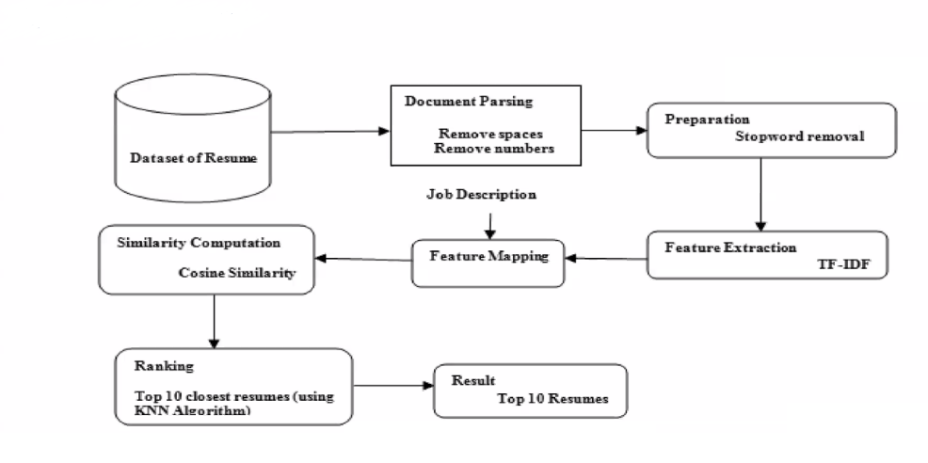
System Architecture

Slide 3
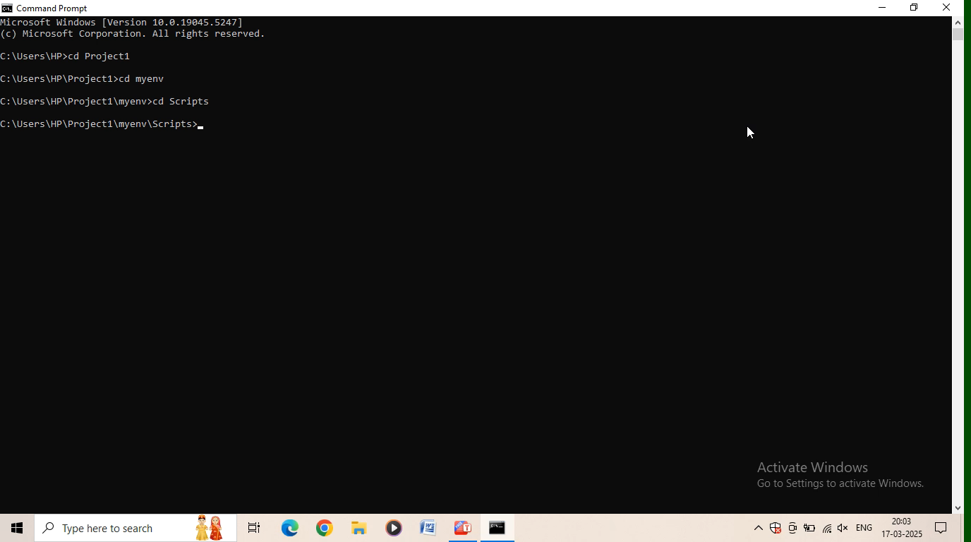
Live Demo of Project

Slide 4
Conclusion
The AI Resume Screening and Ranking System project sucessfully developed an automated tool to streamline the initial stages of candidate selection.
By leveraging NLP techniques and machine learning, the system effectively ranks resumes based on their relevance to job descriptions, significantly reducing the time and effort required for manual screening.
This project demonstrates the potential of AI to enhance the efficiency and accuracy of the hiring process, enabling recruiters to quickly identify top candidates.
By automating the time consuming initial screening process, recruiters can focus on more in depth interviews and evaluations of the top candidates.

Slide 5
Future Scope
To further enhance the AI Resume Screening and Ranking System, several improvements can be considered :
Firstly, incorporating more advanced Natural Language Processing (NLP) techniques, such as Named Enitity Recognition (NER) and semantic analysis, can improve the system's understanding of resume content and job requirements.
Secondly, integrating machine machine learning models for skill extraction and competency assessment can provide a more nuanced evaluation of candidate suitability.
Finally, expanding the system's capabilities to handle diverse resume formats beyond PDFs and integrating with applicant tracking system (ATS) would enhance its practicality.

Slide 6
Thank you!
Notes:
thank you very much for joining this PPT, keep learning.
6

